Slide 1
Regular Languages and Properties

Slide 2
Regular Languages
A language that can be defined by a regular expression is called a regular language.
Closure Properties
Decision Properties
The language that cannot be defined by a regular expression are nonregular languages e.g. PALINDROME, PRIME

Slide 3
Closure Properties of Regular Languages
If certain languages are regular, and a language L is formed from the application of some special operations, then L is also regular.
Principal Closure Properties
  Union of two regular languages is regular
  Complement of a regular language is regular
  Intersection of two regular languages is regular
  Closure of a regular language is regular
  Product / Concatenation of regular languages is regular

Slide 4
Closure Properties of Regular Languages (Union)
If L and M are regular languages over alphabet ∑ then L U M is the language that contains all strings that are in either or both of L and M.
L={ a, ab, ba} M={ ab, bb, aba}
L U M = { a, ab, ba, bb, aba}
“Union of Two regular languages is regular” i.e. Set of regular languages is closed under union.

Slide 5
Closure Properties of Regular Languages (Union)
Proof (By Regular Expression)
If L1 and L2 are regular languages, there are regular expressions r1 and r2 that define these languages. Then (r1+r2) is a regular expression that defines the language L1+L2. Hence L1+L2 (L1 U L2) is a regular language.

Slide 6
L1={ a, ab, ba} L2={ ab, bb, aba}
r1= (a+ab+ba) r2= (ab+bb+aba)
L1 U L2 = { a, ab, ba, bb, aba}
r1+r2
R3= (a+ab+ba) + (ab+bb+aba)

Slide 7
Closure Properties of Regular Languages (Union)
Proof by Machines
-
Λ
Λ
-
-
TG1
TG2
+
+

Slide 8
Another Method
Example
We will consider two FA’s
Then Construct the FA for the Union of These FA’s

Slide 9
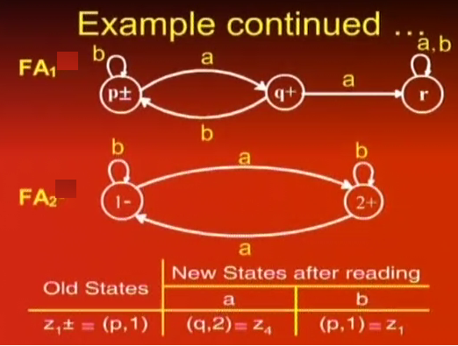

Slide 10
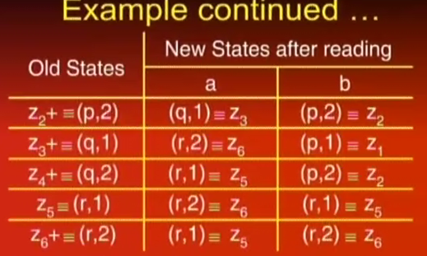

Slide 11
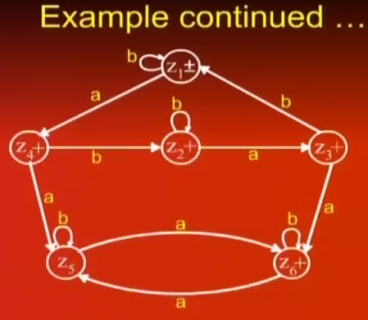

Slide 12
Closure Properties of Regular Languages (Complement)
If L is a language over the alphabet ∑, then its complement denoted by L’ is a language consisting of all strings from ∑* that are not words in L.
∑={a,b}
∑*={^, a, b, ab, bb,ba,aa,aba,…….}
L={aa, bb, ab,bbb}
L’ = ∑*- L ={^, a, b, ba, aba, bbbbbb,abab, ….}
If L is a regular Language, then L’ is also a regular language. i.e. the set of regular languages is closed under complementation

Slide 13
Closure Properties of Regular Languages (Complement)
Proof
  If L is a regular language then Kleen’s theorem states that there is some FA that accepts the language L.
  This FA contains some final states. Reverse the final status of each state.
  This new FA will now accept all the strings that were previously being rejected and reject all the previously accepted strings i.e it accepts the words of L’.
  Thus this new FA defines L’ which by Kleen’s theorem indicates that L’ can also be defined by a Regular Expression and hence is a Regular language

Slide 14
Closure Properties of Regular Languages (Complement)
Example {aba, abb}
a
b
a,b
a
b
a,b
-
+
-
+
+
+
a
a
b
b
a,b
a,b
+
a,b
a,b

